Slide 1
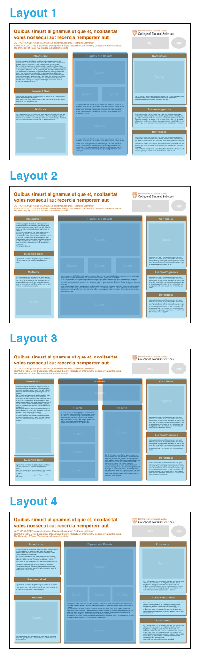
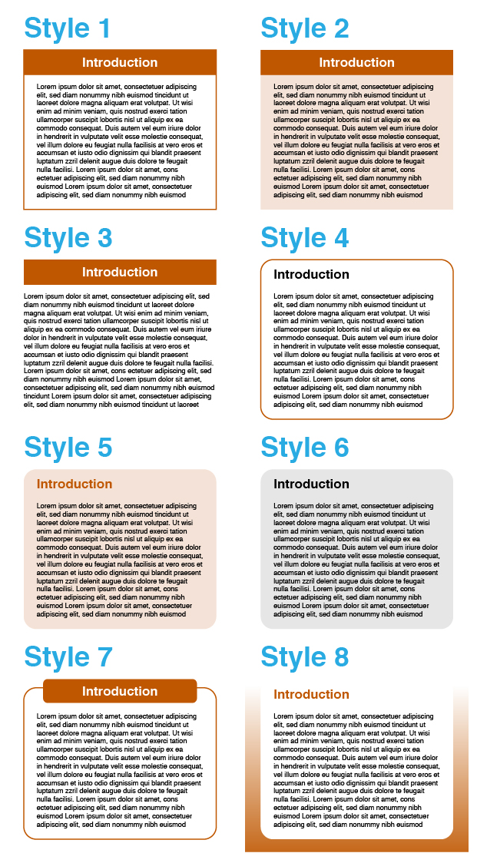
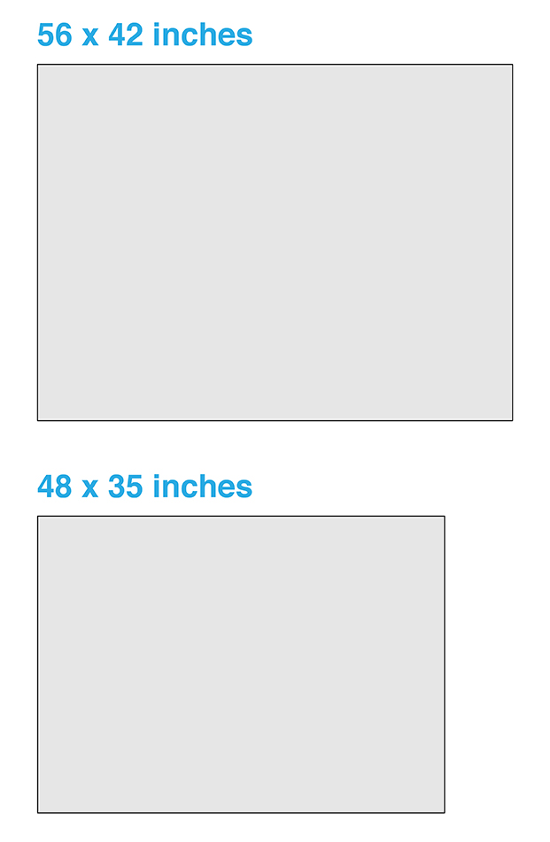
BEFORE YOU START
CHOOSE
A LAYOUT
Different forms/amounts of content might be suited to different column arrangements. These 4 layouts provide a choice of 3-column, 3-column with a wider middle column, a 4-column, and 4-column with the middle columns combined. Think about how your content will be organized and how much space you will need for introductory and concluding information versus data/figures. These options are all provided in this template file.
CHOOSE A SIZE
These templates are available in two sizes, one (larger) is the recommended size for the Undergraduate Research Forum, and one (smaller) might be better for traveling, as it fits in a 3ft poster tube. If you need the other size, download the other template file.
CHOOSE A STYLE
There are 8 different ‘cell’ styles, with various approaches to the headers and border or background. These options are all provided in this template file.
OTHER TEMPLATE FILE
NEXT
Once you’ve chosen the template page that best suits your project, delete other template pages (it might be helpful to keep the following basic tips pages for reference while editing) and save the file under a new name.
THIS FILE

Slide 2
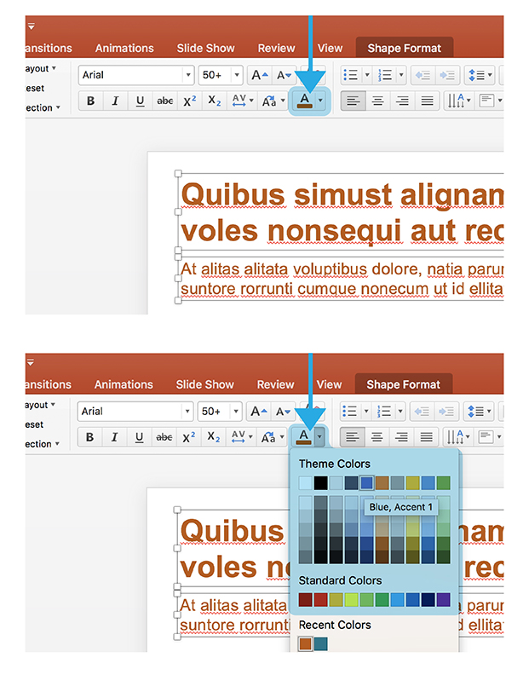
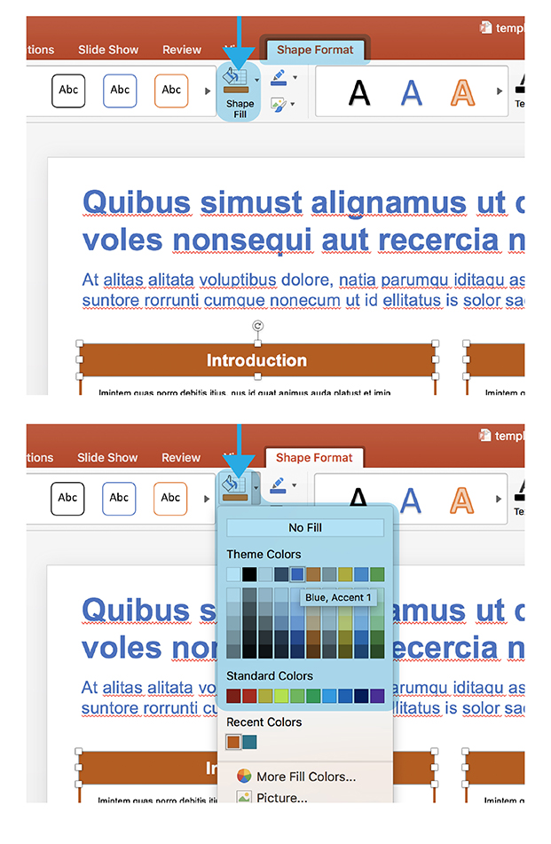
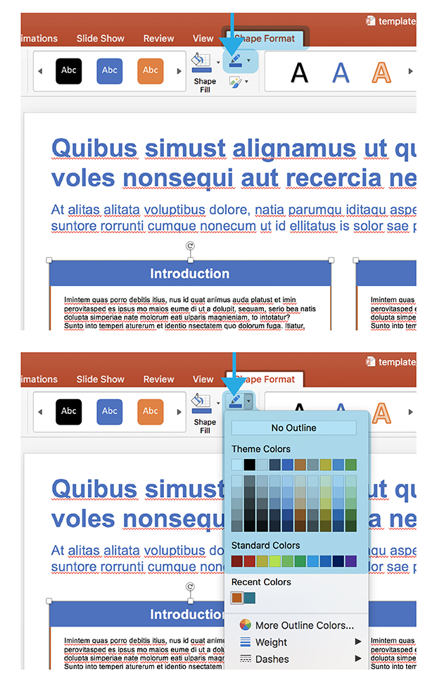
EDITING BASICS
NOTE: DO NOT ADD A DARK BACKGROUND BEHIND AREAS OF TEXT
White text against a dark background might look acceptable on screen, but can be problematic in printed form. Large areas of dark colors can print differently than expected, and highly saturated ink can bleed into white letters and make the text less legible. White text against a background can be useful for things like bold headers (with larger text), but shouldn’t be used for full paragraphs with small text.
CHANGING COLORS
All templates included here are built with UT burnt orange as the accent color, but these colors can easily be changed to fit the tone of your content. To do this, you need to know how to change the shape fill, shape outline, and text color.
TEXT COLOR
From either the “home” tab or “shape format” tab, find the ‘A’ with a color block below.
SHAPE FILL COLOR
From the “shape format” tab, find the paint bucket icon with a color block below, and choose from the given swatches or “more fill colors”.
SHAPE OUTLINE COLOR
From the “shape format” tab, find the pencil icon with a color block below, and choose from the given swatches or “more outline colors”.
GRADIENTS: For editing gradients, go to the bottom of the Shape Fill dropdown and choose: Gradient > More Gradients

Slide 3
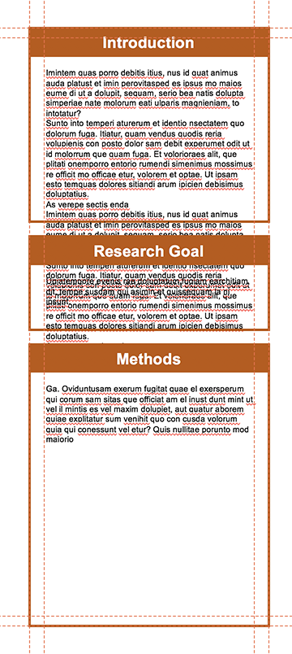
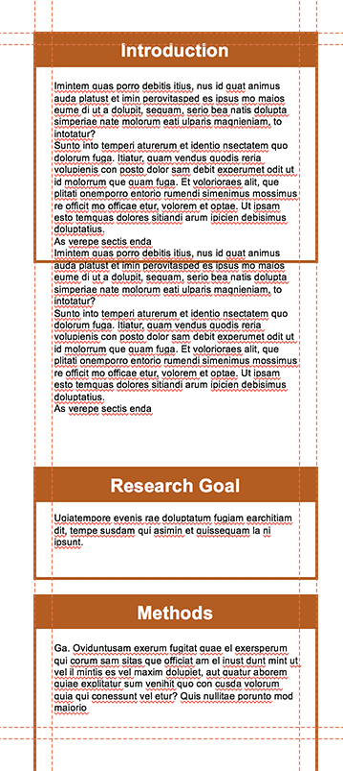
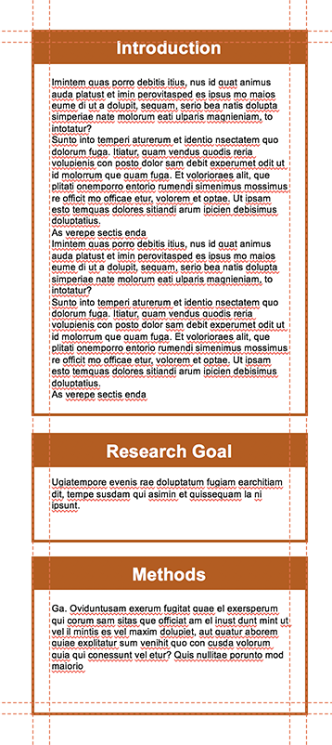
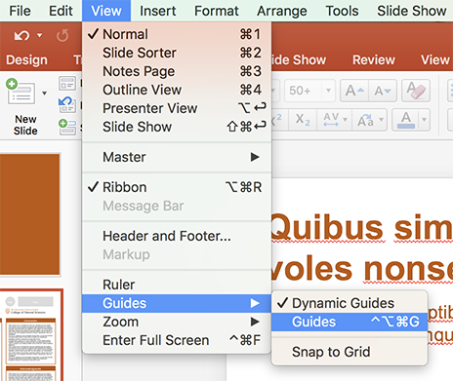
EDITING BASICS
NOTE: These templates include suggested headers for cells (introduction, research goal, methods, etc), but these are in no way strict guidelines, and can be changed according to what would be appropriate for your content.
MAKING CHANGES TO CELLS
Most research posters are made up of multiple text boxes with headers, which I’m referring to as ‘cells’. As you add in your own content, the length and number of these cells will probably change. Maintaining the column width as it was designed will preserve the alignment of cells and keep the poster looking polished.
MAKE GUIDES VISIBLE
Guides have been set up in the file to create visible boundaries to align elements as you make changes to the content (these will not show up when printed). If you do not see them upon first opening the file, you can make them visible by going to: View > Guides > Guides
ADJUST CELL TO FIT TEXT LENGTH
With guides visible, copy and paste your own text, and adjust the borders or background shape of the cells to fit the new content.
1
2
3
NOTE
These guides might not show up if you are opening this up in an older version of powerpoint, update the software to utilize this feature in the file.

Slide 4

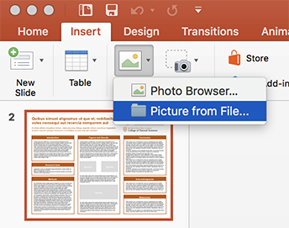



EDITING BASICS
INSERTING AND SCALING IMAGES
INSERTING IMAGES
Insert new images by either dragging them onto the page, or going to the “insert” tab, clicking on the picture icon, and choosing ”picture from file”
SCALE IMAGES PROPORTIONALLY
Make images bigger or smaller by dragging from one of the corner anchor points.
Do NOT scale any images by using anchor points directly horizontal or vertical, which gives the image the appearance of being stretched, as this would result in a significant misrepresentation of a logo or inaccurate depiction of data/charts.

Slide 5



LOGOS
FOR CURRENT LOGO DOWNLOADS
If you do not have the current logos for the College of Natural Sciences, its departments, or its research centers/institutes, those files can be downloaded here:
https://cns.utexas.edu/communications/style-guide/downloads
University-level logos can be downloaded here:
https://brand.utexas.edu/identity/logos/
For more information about proper use versus misuse of CNS logos, visit:
https://cns.utexas.edu/communications/style-guide/logos-fonts-colors
MOST OF THESE LOGOS ARE ALREADY INCLUDED ON PAGE 6.
DO NOT USE OUTDATED LOGOS
Check to make sure you are not using an outdated version of that group’s logo (for example, the CNS official logo is now the version that incorporates the university shield, and the nautilus version of the logo should be retired for all uses).
DO NOT USE REDUNDANT LOGOS
Consider the number of logos you are using and remove those that are repetitive. For example, you do not need the UT logo and the College of Natural Sciences logo and the FRI logo, because the official FRI logo includes three lines of text that read “The University of Texas at Austin, Freshman Research Initiative, College of Natural Sciences”. If you are just representing CNS and want to use the CNS logo, you do not need to represent the university separately (with the UT logo, UT seal, longhorn icon, etc) because “The University of Texas at Austin” is also in the CNS logo.
INCLUDING OTHER LOGOS
If you need to include other logos, acknowledging funding support or partnership with other institutions, there are placeholders for such logos in the top right corner. Delete these gray shapes and position your logo files here. COMMONLY USED FUNDING LOGOS ARE ALREADY INCLUDED ON PAGE 7.

Slide 6

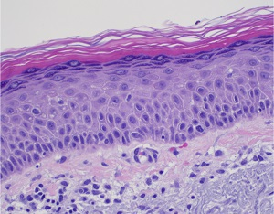
Sanctum Healthcare Marketplace
Billy Nguyen, Jacob Marquardt, Mihir Ali, Umar Choudry, Saleh Ahmad, and Helen Liu Faculty Mentor: Dr. Sriram Vishwanath
Abstract
Design Solution
System Architecture/Data Flow
Imintem quas porro debitis itius, nus id quat animus auda platust et imin perovitasped es ipsus mo maios eume di ut a dolupit, sequam, serio bea natis dolupta simperiae nate molorum eati ulparis magnieniam, to intotatur?
Sunto into temperi aturerum et identio nsectatem quo dolorum fuga. Itiatur, quam vendus quodis reria volupienis con posto dolor sam debit experumet odit ut id molorrum que quam fuga. Et volorioraes alit, que plitati onemporro entorio rumendi simenimus mossimus re officit mo officae etur, volorem et optae. Ut ipsam esto temquas dolores sitiandi arum ipicien debisimus doluptatius.
As verepe sectis enda di incto etusda delectet eaque simusda ndanimus, sin cori rem id maximillut hari con ea quiam quam et enduci idunt, corecta alicimp
Billy diagrams
Vitam voloria con et, cum laboreium, nam cum, quat paris as core volorest, sust exceatur antio ea voluptas eumquatendit quas doluptatet aut landignam que lantur sania dem escidit min reruptiaero velis maximus aut que pe aliquas sequidisit, omnient hit lam eicias modio con nisin pediam, ent, cust accaborit odio corehen dendae nonet eliquam, aperorepe autatem voles int odic tem nis dolorrum que cores doluptaturi utemolorum imusam,
Goal
Ugiatempore evenis rae doluptatum fugiam earchitiam dit, tempe susdam qui asimin et quissequam la ni ipsunt.
Ditat que voluptat. Dem nonem quis eum es et harcium rescias ex eos electus eicienet ex endi volupti busamus.
figures
figures
figures
Conclusion
Design Problem
figures
Imintem quas porro debitis itius, nus id quat animus auda platust et imin perovitasped es ipsus mo maios eume di ut a dolupit, sequam, serio bea natis dolupta simperiae nate molorum eati ulparis magnieniam, to intotatur?
Sunto into temperi aturerum et identio nsectatem quo dolorum fuga. Itiatur, quam vendus quodis reria volupienis con posto dolor sam debit experumet odit ut id molorrum que quam fuga. Et volorioraes alit, que plitati onemporro entorio rumendi simenimus mossimus re officit mo officae etur, volorem et optae. Ut ipsam esto temquas dolores sitiandi arum ipicien debisimus doluptatius.
As verepe sectis enda di incto etusda delectet eaque simusda ndanimus, sin cori rem id maximillut hari con ea quiam quam et enduci idunt, corecta alicimp oriaeperum et
The healthcare industry still relies on fax machines to transmit patient information and data, including test results, diagnostic images, and insurance forms despite the fact that faxes are largely deprecated from widespread usage. Most physicians have databases of information collected from their own patients, but lack the means to collaborate and pool data with others. Sanctum alleviates this problem by providing a platform and an incentive for which to share verified data and allow users to build machine learning models from the data, increasing diagnostic efficiency and accuracy as more data is shared. Idk I just making stuff up
figures
Vitam voloria con et, cum laboreium, nam cum, quat paris as core volorest, sust exceatur antio ea voluptas eumquatendit quas doluptatet aut landignam que lantur sania dem escidit min reruptiaero velis maximus aut que pe aliquas sequidisit, omnient hit lam eicias modio con nisin pediam, ent, cust accaborit odio corehen dendae nonet eliquam, aperorepe autatem

